Slide 1
Sepsis in pregnancy : Recognition, Diagnosis, and Management (surviving sepsis)
Arthur Jason Vaught, M.D.
Maternal-Fetal Medicine
Surgical Critical Care
Johns Hopkins University
Robert E. Meyerhoff Professor

Slide 2
Patient Vignette
33 year old G1P0 at 40+1 admitted for IOL at term.
Cervix = 0/0/-4 → Foley Bulb + Misoprostol
Rupture of Membranes
Prolonged Labor Course
Low UOP and abnormal labs
Serum Creatinine 1.3 mg/dL

Slide 3
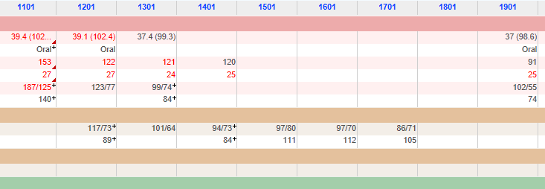
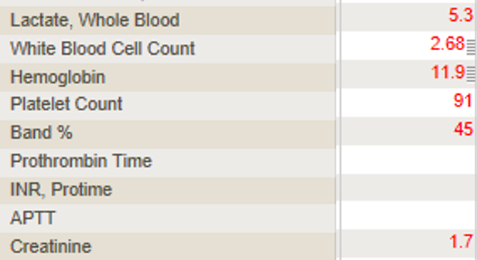
Patient Vignette
Postoperatively called to PACU for agitation and anxiety
Differential Diagnosis

Slide 4
Differential Diagnosis
Bleeding
Pulmonary Embolism
Sepsis
Less Common
Amniotic Fluid Embolism
Malignant Hyperthermia
Psycho-somatic

Slide 5
Sepsis Lecture Outline
Historical background and epidemiology of sepsis and maternal sepsis
Describe the general principles of the Surviving Sepsis Campaign as it relates to pregnancy
Discuss patient and provider risk factors for sepsis
Discuss future direction

Slide 6
Incidence
Sepsis is leading cause of death of the critically ill in U.S.
Third leading cause of maternal deaths in US
5% of maternal ICU admissions
4-10 per 10,000 births
Guinn, D. Obstet Gynecol Clin N Am. 2007
Van Dillen, J.Current Opinion in Infectious Disease. 2010
Albright, C. AJOG. 2014

Slide 7
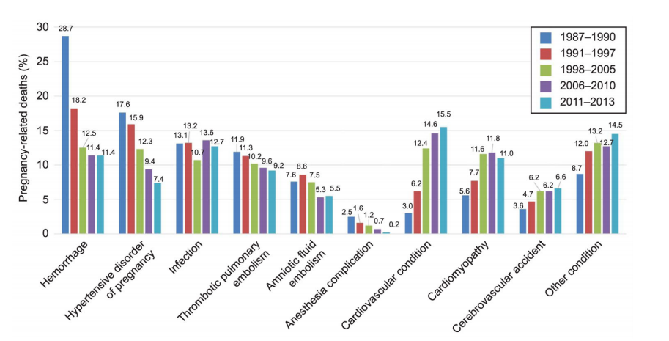
Why is this topic important?
Creanga. Obstet Gynecol. 2017
Notes:
Despite improvements in hemorrhage, HDP, and PE thee has been little to know change in infection or sepsis.

Slide 8
Why has there been no improvement?
Knowledge gap in current definition, recommendations, and guidelines
“She’s not septic because her blood cultures are negative…”
Inability to identify patients with disease
“You don’t think she’s septic do you…”
When disease is identified, failure to recognize severity or critical illness
“She’s septic, but is she septic septic…”
“She’s only a little septic…”

Slide 9
How do we define Sepsis in 2021 ?
SIRS → septic shock
SIRS

Slide 10
How do we define sepsis in 2021: SIRS discontinued
Not a great screening tool
Focus on inflammation
Does not reflect who goes to the ICU
Hypotension, AKI, Mental Status Change, etc.
Patient with the common cold or pancreatitis can be diagnosed with sepsis
Low sensitivity and Low specificity
Shankar-Hari. Intensive Care Med. 2015

Slide 11
How do we define sepsis in 2021: qSOFA Score
qSOFA
Respiratory Rate > 22
Altered Mental Status
Systolic Blood Pressure < 100 mm Hg
2 of the 3 clinical variables offered similar predictability of sepsis to that of SOFA
Singer, M. JAMA. 2016

Slide 12
How do we define sepsis in 2021: qSOFA Score (obstetric modified)
Society of Obstetric Medicine Australia and New Zealand (SOMANZ)
qSOFA (maternal)
SBP < 90 mmHg
Respiratory Rate > 25
Altered Mental Status
Lab changes
Changed abnormal serum creatinine > 1.02 mg/dL
Notes:
SMFM Consult series #47. Plante et al. AJOG 2019

Slide 13
Adjuncts to diagnosis: Procalcitonin
In healthy state
Precursor of calcitonin produced by CALC-1 gene in the thyroid
Low levels ( <0.1 ng/mL)
In Septic State
Direct: Produced by LPS or toxic metabolites of microbes
Indirect: up-regulation IL-6, TNF-alpha
Level usually peak within 6 hours of bacterial infections
Vijayan. J Instensive Care. 2017
Notes:
Many reports are available which shows that PCT levels are elevating rapidly between 2 and 6 h which peaks within 6–24 h during bacterial infection.

Slide 14
Procalcitonin: Diagnostic tool
Elevated levels have shown to be helpful in diagnosing bacterial infections (especially pulmonary)
Delineates viral versus bacterial infections
Level > 0.2 is indicative of bacterial infection
Level > 2.0 can is associated with higher mortality
Levels unchanged in pregnancy
Aids in antibiotic stewardship
Immunocompromised
Baseline high inflammatory states
Vijayan. J Instensive Care. 2017
Muller. BMC Infect Disease. 2007
Scheutz. Cochrane. 2018

Slide 15
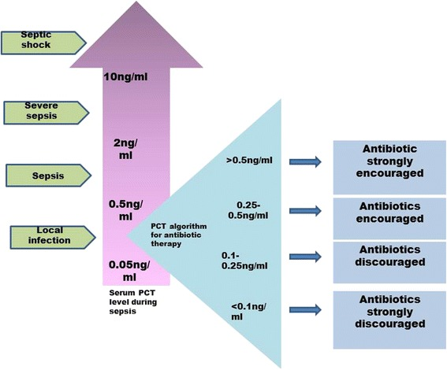
SEND OUT LAB!!!
Vijayan. J Instensive Care. 2017

Slide 16
Patient Vignette
Diagnosed with sepsis!
SIRS: WBC = 2.8, Bandemia = 45%, Fever , Tachycardia
qSOFA: SBP < 90 mmHg, tachypnea, agitation (AMS)
SOFA: Renal injury, Lactemia
Source: Endomyometritis
Now What !!!

Slide 17
Definition of Septic Shock
Sepsis + persistent hypotension and lactic acidosis despite adequate fluid resuscitation
Dillenger, R. Critical Care Medicine. 2013
Notes:
We will go into later in the lecture on what adequate fluid resuscitation is

Slide 19
Septic Shock: Cultures
Preferred to obtain 2 sets blood cultures before antibiotic administration but do not delay past 45 minutes
No longer than 45 minute delay
However
Rapid sterilization can occur within few hours of first dose of antibiotic
Helps with de-escalation of antibiotics and effectiveness of treatment

Slide 20
Septic Shock: Antimicrobials
Administration in first hour
Each hour in delay of shock increases mortality
Take into account patient history
Antibiotic exposure and Hosp. Admission
Past Medical History: Autoimmune disorder, Transplant
Colonization: Pseudomonas (Cystic Fibrosis)
Implanted devices
Job, Travel, Extra-Curricular Activity
Kumar, A. Crit Care. 2006

Slide 21
Septic Shock: Antimicrobials
Go Big and Broad in septic shock
Resistant Gram Positives (MRSA, VRE)
Vancomycin, Daptomycin, Linezolid
Resistant Gram Negatives
Pipercillin/Tazobactam, Carbapenemases
CMV infections
Valgancyclovir
Invasive Fungal Infections
Micafungin, Caspofungin

Slide 22
Septic Shock: Antimicrobial
Dose correctly in septic shock
Increased volume of distribution
Increased Compartmentalization
Compounded by both sepsis and pregnancy
Increased GFR
Increase CYP3A4 and CYP3A5
Sub-therapeutic levels
Vancomycin
Aminoglycosides (postpartum)
Carbapenemases
Penicillins

Slide 23
Septic Shock: Resuscitation
Measure a Lactate
Clearance of lactate is the gold standard for endpoints of resuscitation
Intravenous fluids
MAP goal of 65 mmHg (per SCCM)
Crystalloid initial fluid choice
0.9% Normal Saline, Lactated Ringers, Plasmalyte
30 cc/kg bolus within 3 hours
Albumin (5%, 25%) can be used if large amounts of crystalloid are used
Rhodes, A. Critical Care Medicine. 2017
Dillenger, R. Critical Care Medicine. 2013

Slide 24
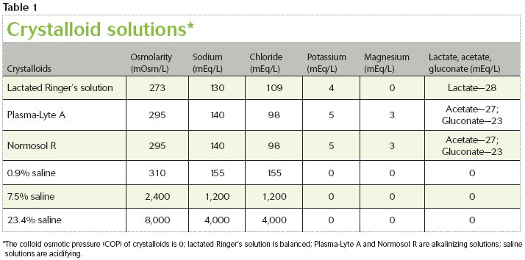
Septic Shock: Resuscitation
Balanced
Plasmalyte
Lactate Ringer
Unbalanced
0.9% NS

Slide 25
Septic Shock: Resuscitation
Loss of oncotic pressure
Lower albumin and total protein
Increase in intravascular free water
Capillary leak
Vasodilation
Perhaps 30 cc/kg can be too much
Consider 20 cc/kg over 3 hours

Slide 26
Septic Shock: Resuscitation
Norepinephrine is first line choice
Dosing to MAP 65 (0.02 mcg/kg/min – 1 mcg/kg/min)
Going over 0.2 mcg/kg/min is concerning
Tachyarrhythmia, Reflex bradycardia
Lactic acidosis in under-resuscitated patients
Something isn’t working / Am I missing something
Rhodes, A. Critical Care Medicine. 2017
Dillenger, R. Critical Care Medicine. 2013

Slide 27
Re-measure a lactate

Slide 28
Septic Shock: Adjuncts to Resuscitation
High dose hydrocortisone – Relative adrenal insufficiency
Supplemental vasopressin infusion – Vasopressin insufficiency
Minimizing oxygen debt – Red Cell Transfusion if low central venous gas
Rhodes, A. Critical Care Medicine. 2017
Dillenger, R. Critical Care Medicine. 2013

Slide 29
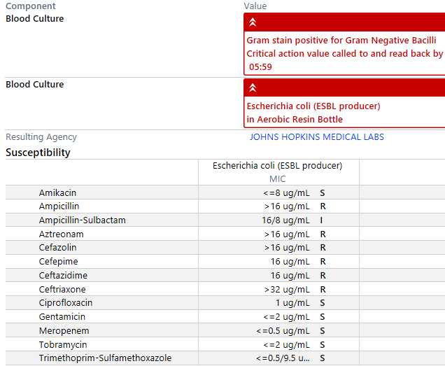
Patient Vignette
3L fluids
Blood cultures
Serial Labs
A+G+C
Improved in 12 hours
No ICU admission
Arterial line
Cardiac monitoring

Slide 30
What if they are not improving? Source Control
Important aspect of surgical sepsis
Procedural vs. Surgical
Antibiotics usually continued 4 days after source control (STOP-IT Trial)
Consider blood culture data
Resistance data
Global critical illness of the patient
Sawyer, et al. NEJM.2015

Slide 31
Thank you

